Slide 1
Content based Recommendation System for Electronics and Multi-category Store
Anshul Patil

Slide 2
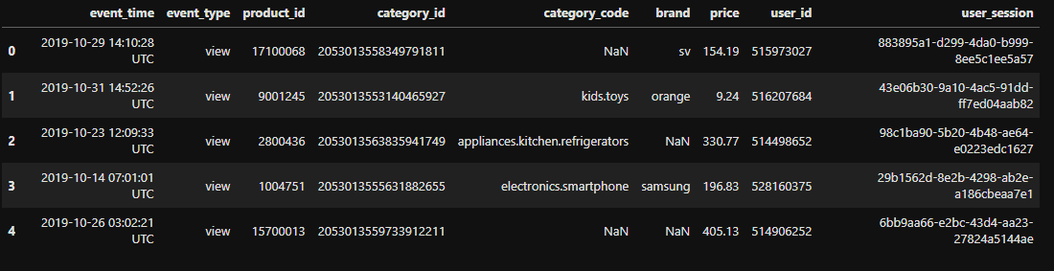
Data Overview
The dataset used are open source datasets available on Kaggle, consists of three csv files, where each csv files holds the transaction records for and electronics and multicategory stores.
Each of these CSVs various attributes to provide information regarding the transactions like event_time, event_type, product_id, category_id, category_code, brand, price, user_id, user_session.
The attributes define the user id, the event_type attribute defines whether the user has bought the product, viewed the product or added it to the cart.
Attributes like product_id, category_id, category_code and brand help us to determine the unique number of products, the category they lie in and what brand they belong to.
The attribute price describes the selling price of the product

Slide 3
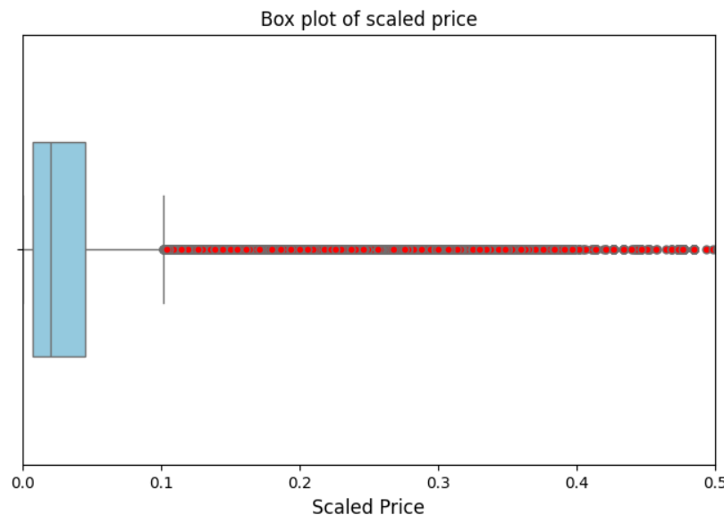
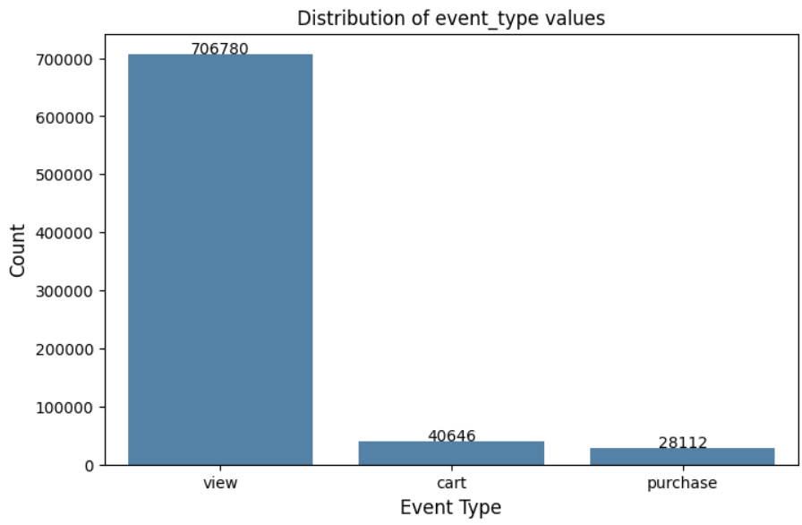
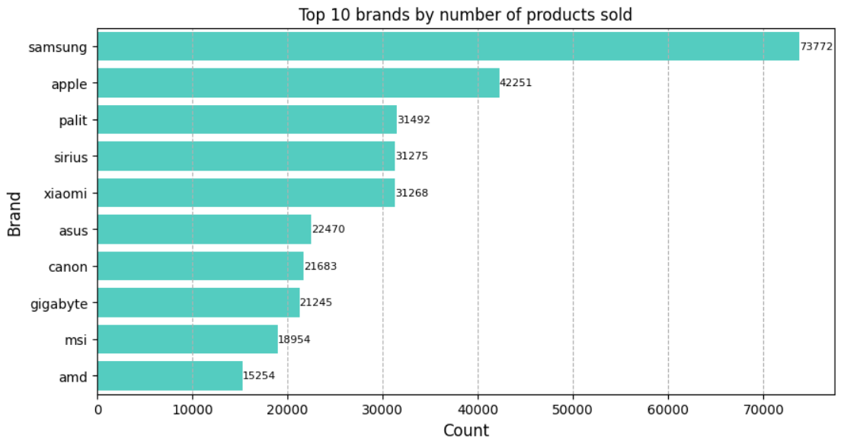
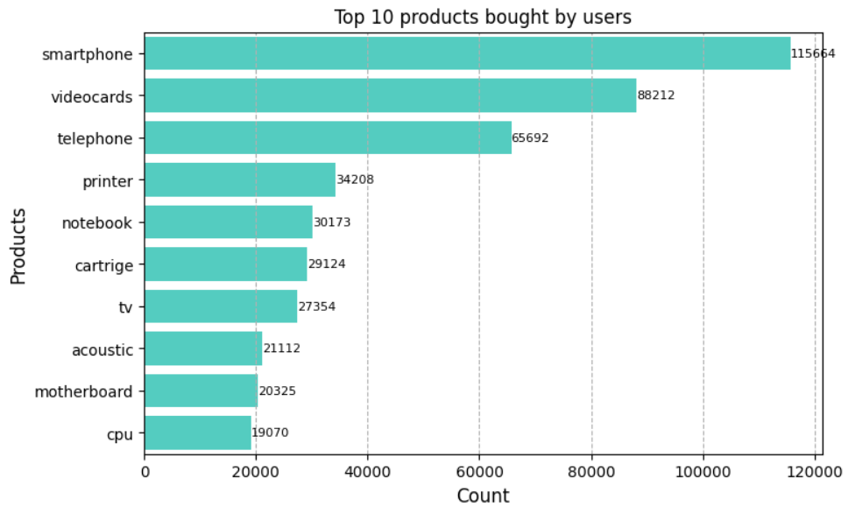
Exploratory Data Analysis
This is a crucial step in any machine learning process as it helps us to identify the data distribution and the hidden patterns in the data.
In this project, I have utilized EDA techniques for the following tasks
To get the statistical attributes for the numerical columns
To visualize the distribution of the price column, to figure out the price range of the frequently bought products.
To identify the outliers in the price column using boxplot
Utilizing bar chart to understand the distribution of values in event_type column
Using horizontal bar chart to find the brands with most sold products
To visualize the most bought product by users

Slide 4
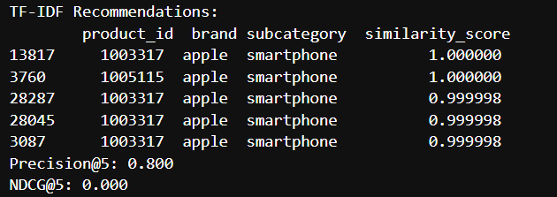
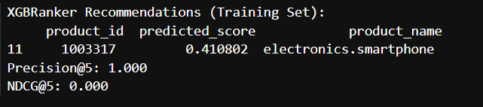
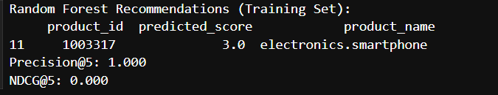
Model Selection
Three different models(approaches) were used to build the content based recommendation system:
TF-IDF and cosine similarity:
In this approach the textual data was vectorized using the ‘term frequency- inverse document frequency’ vectorizer. Then after stacking the categorical data onto the numerical columns the cosine similarity was calculated among the vectors
Based on the highest cosine similarity values, users were provided with personalized recommendations
XGBoost:
The XGBoost model was trained and tuned to find the best set of parameters on the transaction data
The users were then provided with personalized recommendations on the best model
Random Forest:
The random forest estimator was trained on a specific set of set of attributes
The estimator was then used for recommending products to users.

Slide 5
Takeaways and Future work
Takeaways
Model Performance: TF-IDF, XGBRanker, and Random Forest showed varied recommendation outcomes, but all yielded zero Precision@5 and NDCG@5, indicating challenges in capturing significant user actions (e.g., cart or purchase) on the training set.
Data Limitations: Using a smaller dataset due to computational constraints likely contributed to sparse interactions, impacting metric scores and recommendation relevance.
Approach Strengths: TF-IDF excels in content-based similarity, XGBRanker in ranking, and Random Forest in pattern recognition, offering complementary insights for recommendation systems.
Future Work
Larger Dataset: Incorporate a larger dataset to capture more user interactions, potentially improving metric scores and recommendation accuracy.
Hyperparameter Tuning: Optimize Random Forest and XGBRanker models through hyperparameter tuning to enhance predictive performance.
Hybrid Approach: Combine TF-IDF, XGBRanker, and Random Forest into a hybrid model to leverage their strengths, improving overall recommendation quality.
Evaluation Metrics: Refine Precision@5 by thresholding predicted scores, ensuring more accurate relevance assessment.

